Slide 1
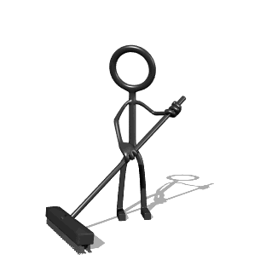
Chores Project
Presented by:
Allan Hartigan
Christine Lanlokun
Gabriela Menocal
Taylor Doodchenko

Slide 2
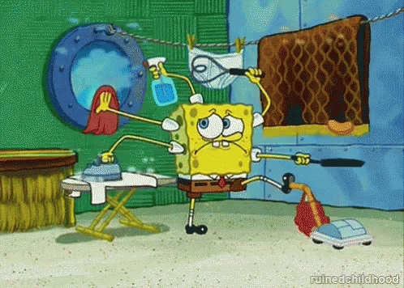
Motivation

Slide 3

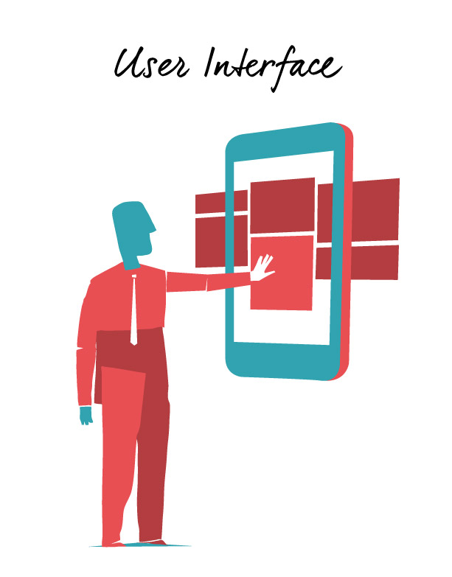

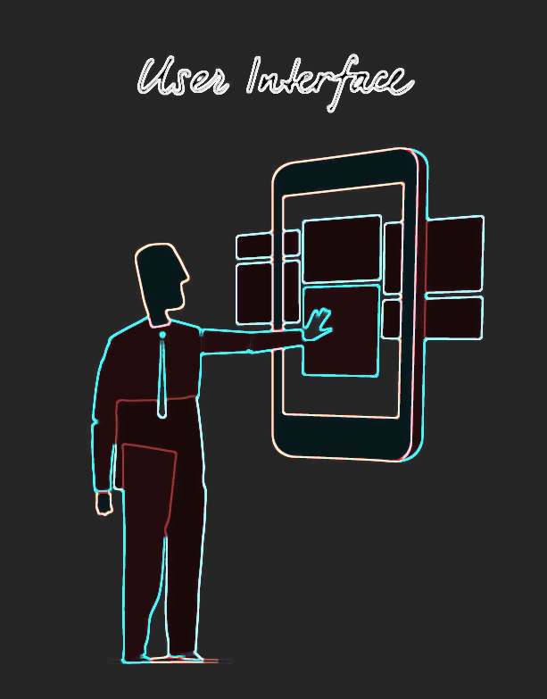
App Description
User’s Interface: UI # 1
Admin’s Interface: UI # 2

Slide 4
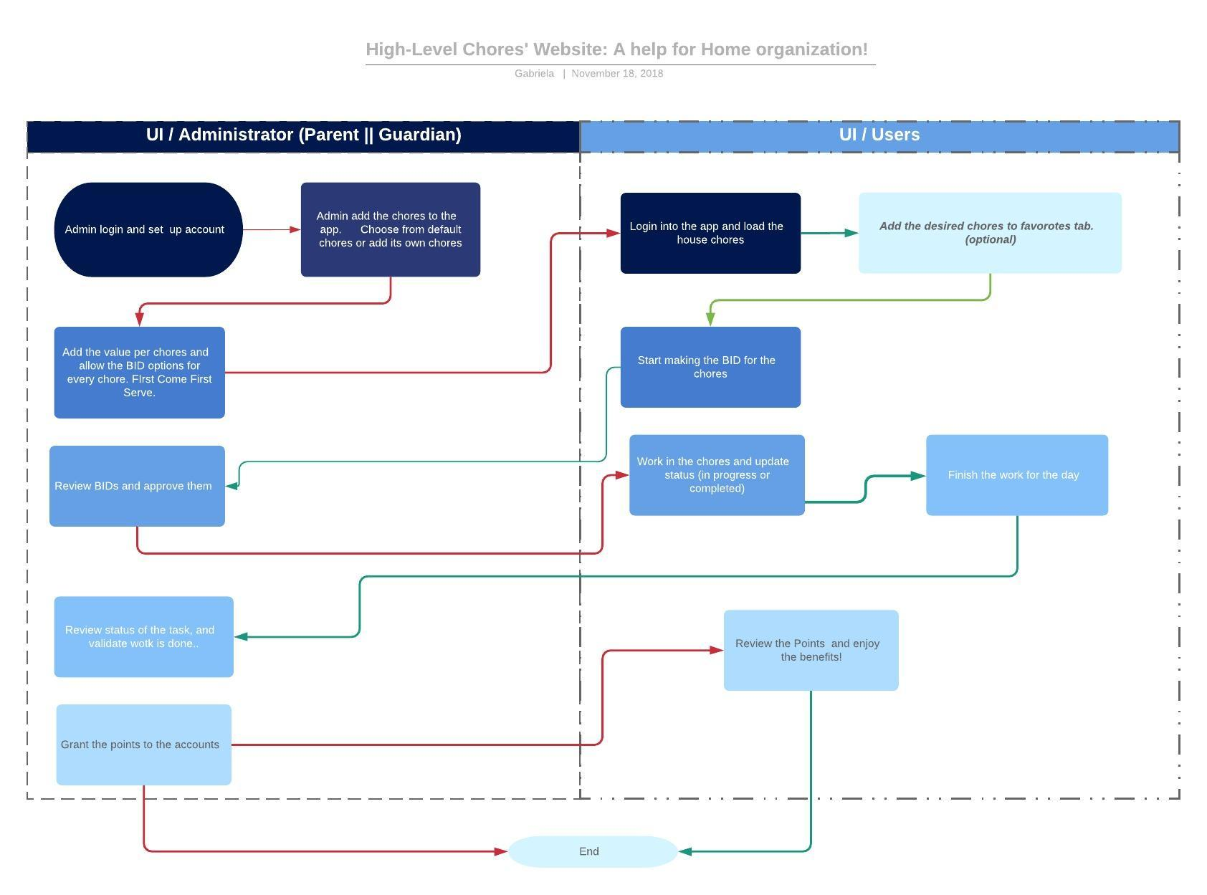
Flowchart v1.0

Slide 5
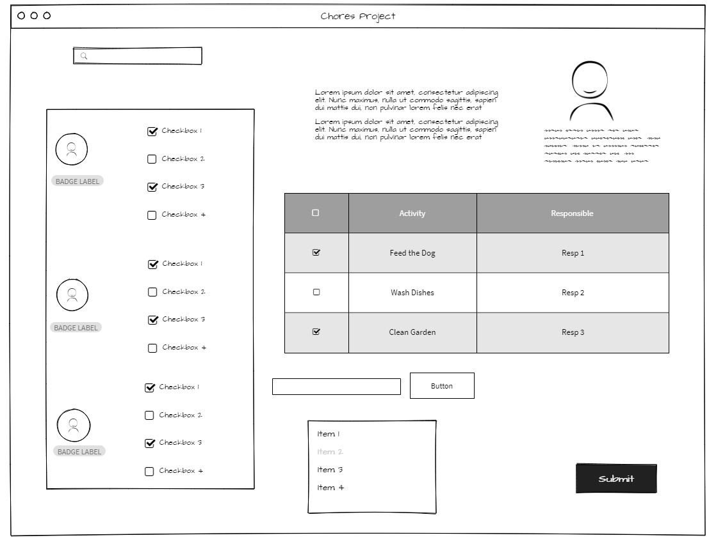
UI # 1: First Draft…

Slide 6

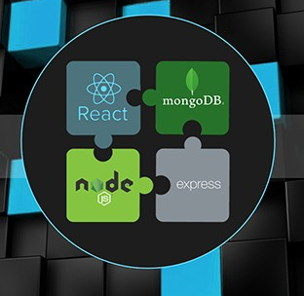


Technologies and tools
Technologies:
M: MongoDB
E: Express
R: React
N: NodeJs.
Some tools:
Lucidchart
MockFlow
AdobeXD
Will continue…

Slide 7

Assigned Tasks (Still under review..)
UI # 1
Backend
UI # 2

Slide 8



